Slide 1

nStore Retech Private Limited
INTERNSHIP DOCUMENTATION

Slide 2

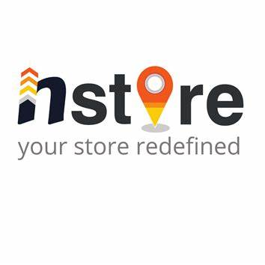

Automatic Customizable Order Management System
Streamlining Order Processing and Delivery
SANJAYKUMAR M
PRESENTER
LinkedIn
https://www.linkedin.com/in/sanjaykumar-m2005/

Slide 3
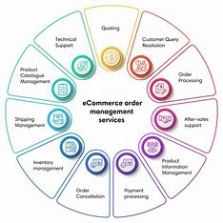
Introduction
Welcome to our presentation on the Automatic Customizable Order Management System. This project aims to automate and streamline the entire order fulfillment process from order placement to delivery, ensuring efficiency and a seamless experience for both the stores and the customers and make it fully customizable for user.

Slide 4


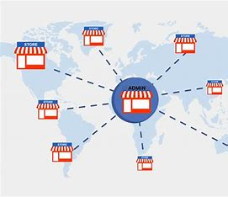

Project Objectives
Automate order processing to minimize manual intervention.
Integrate with multiple stores and delivery partners to expand reach.
Provide real-time tracking and updates to enhance transparency.
Ensure a user-friendly and customizable interface for ease of use.

Slide 5
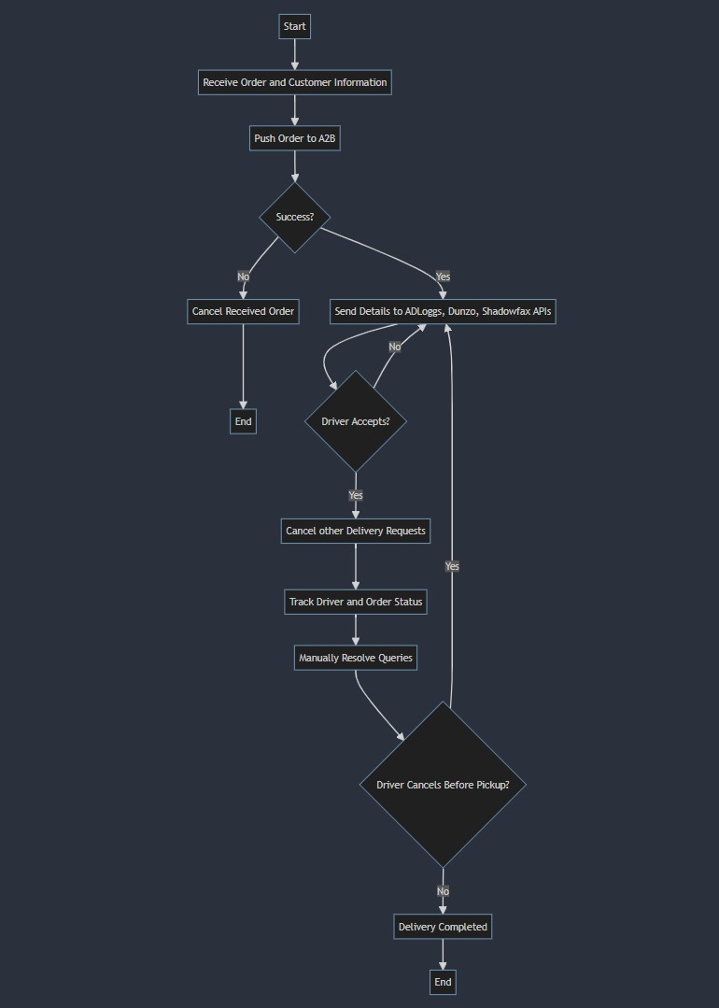
System Architecture
Overview:
Order Data: Fetch from app API.
Order Routing: Send to internal logic if store lacks delivery partners.
Delivery Partner Assignment: API requests to AdLoggs, Dunzo, Shadowfax.
Order Tracking: Monitor delivery status; repeat if driver cancels.
UI Integration: Display real-time order and delivery updates.
Components:
App API: Provides order data.
Internal Logic: Routes orders without partners.
Delivery APIs: AdLoggs, Dunzo, Shadowfax for partner assignment.
Tracking System: Monitors delivery progress.
UI: Shows order and delivery status updates.

Slide 6
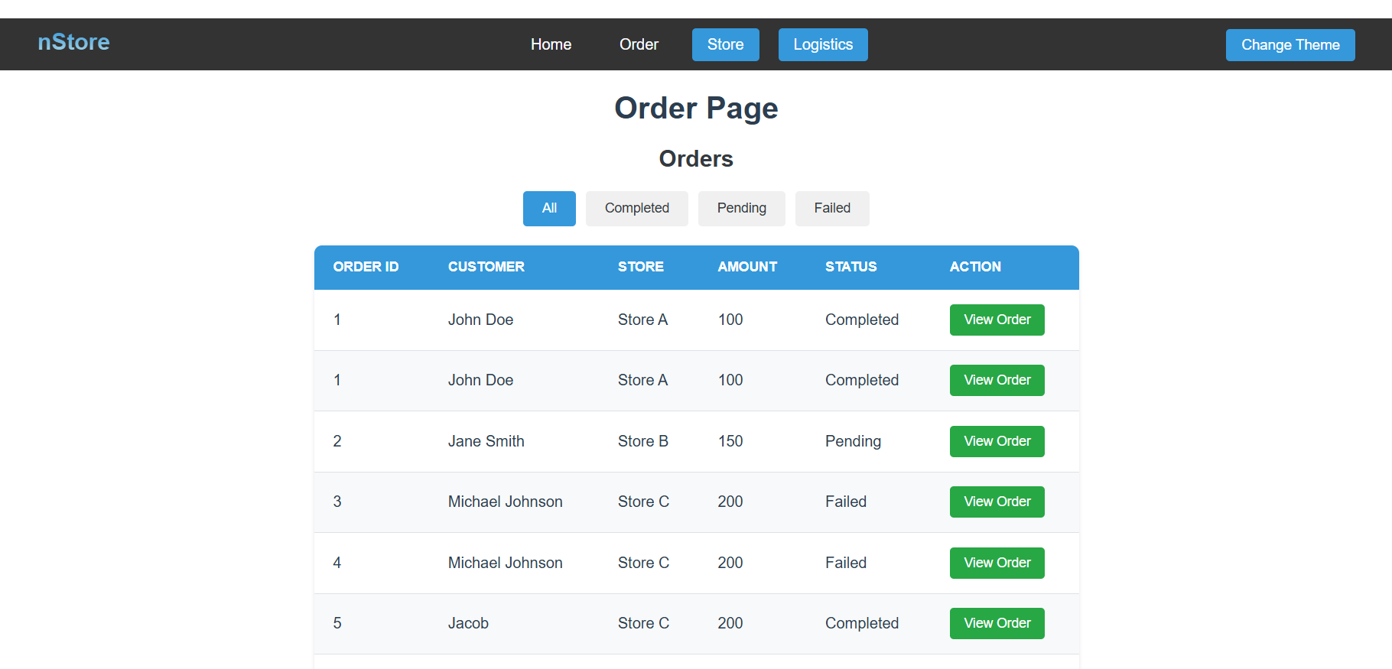
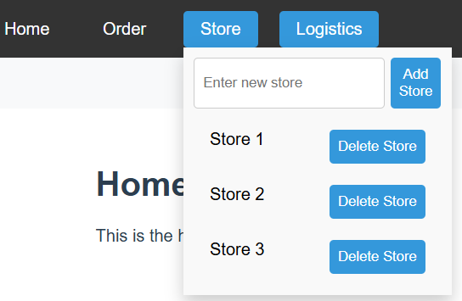
User Interface (UI)
Configurable user interface allows managing stores, delivery partners, and orders.
Customizable for operational flexibility. Manage stores and delivery partners, view/edit order details and statuses, and customize UI to meet business needs.
Easily add, delete, and edit stores/partners. Track orders with comprehensive details. Flexible UI adapts to operational requirements.

Slide 7
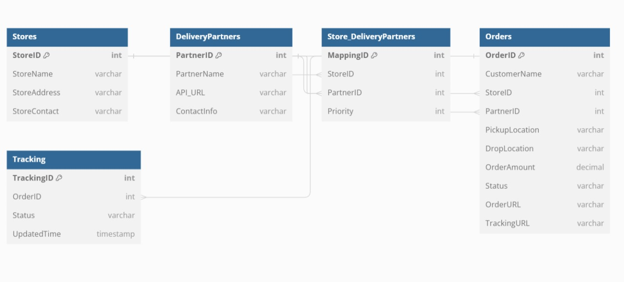
Order Data Management
Orders are received via API, processed for relevant customer info, and evaluated for store delivery partners. If none, orders are assigned to A2B, Adloggs, Dunzo, or Shadowfax based on priority. Data is stored in a database, tracked, and displayed in real-time in the UI, with reassignment if a driver cancels.

Slide 8
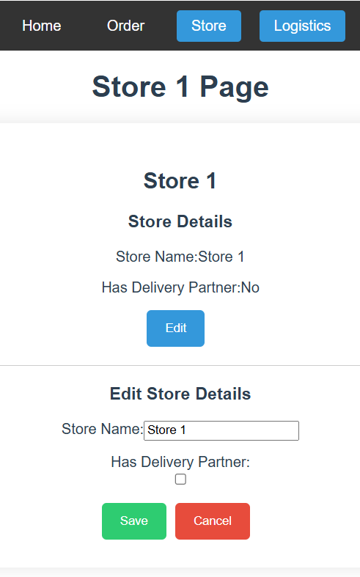
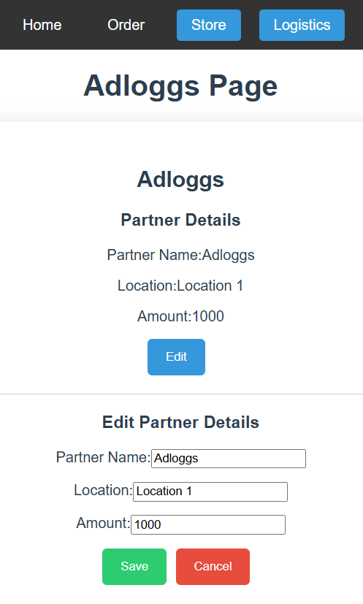
Delivery Partner Integration
API Integration: Seamless integration with multiple delivery partners' APIs for real-time order management.
Partner Assignment Logic: Utilizing a robust regression list algorithm to dynamically assign the optimal delivery partner based on availability and efficiency metrics.
Implementation Details: Demonstrating how API endpoints are configured and managed within the system, ensuring reliable order routing and tracking.

Slide 9
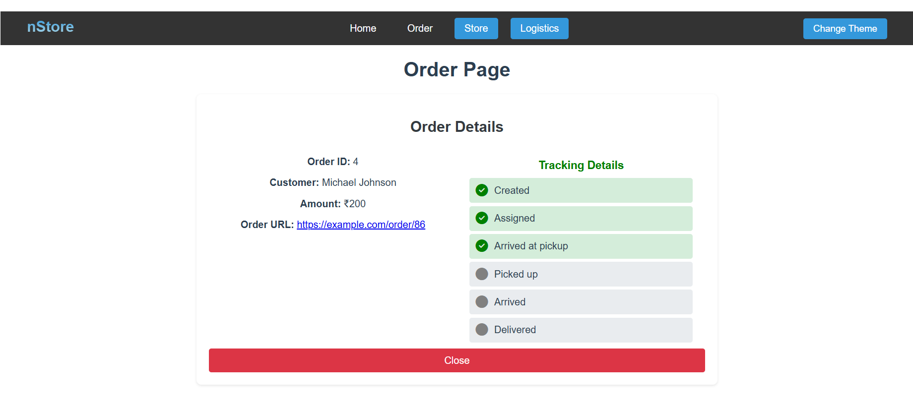
Order Tracking System
Real-time Tracking: Provides live updates on order statuses directly within the user interface.
Integration with Delivery Partners: Displays tracking details fetched from delivery partners' APIs.
User Interface: Features a user-friendly interface showing order progress and links to original delivery partner apps for detailed tracking.

Slide 10



Technical Implementation
Tech Stack:
Frontend: Vue.js
Backend: Node.js, Express.js
Database: SQLite
APIs:
Integration with store and delivery partner
Key Libraries:
vuedraggable for UI components
Axios for API requests
Body-parser and CORS for DOM connection

Slide 11
Challenges and Solutions
Challenges:
Integration Complexity: Managing diverse APIs and data formats from multiple stores and delivery partners.
Technical Hurdles: Addressing CORS issues and ensuring seamless data flow between frontend and backend.
Operational Efficiency: Optimizing processes to handle dynamic order volumes and delivery scenarios.
Solutions:
API Management Strategy: Implemented robust API management practices to handle varied integration challenges.
Cross-Origin Resource Sharing (CORS): Utilized CORS handling techniques to facilitate secure data exchange.
Process Optimization: Enhanced workflows and implemented dynamic scaling strategies for improved efficiency.

Slide 12
Results and Achievements
Project Success:
Automated Order Processing: Reduced manual intervention, enhancing operational efficiency.
Integration Success: Successfully onboarded diverse stores and delivery partners.
Enhanced Visibility: Improved customer experience with comprehensive order tracking capabilities.
Operational Benefits:
Efficiency Boost: Reduced processing times and streamlined workflows.
Customer Satisfaction: Enhanced service levels with real-time updates and notifications.
Scalability: Configurable system prepared for future growth and feature expansion.

Slide 13
Conclusion
Recap of Project Objectives and Outcomes:
Objectives: Our project aimed to automate and streamline order processing, offering a configurable and customizable system. We integrated with diverse stores and delivery partners, enhancing operational efficiency.
Outcomes: Successfully reduced manual workloads through automation, provided a user-friendly interface for seamless operations, and improved order management across all partners.
Benefits of the System:
Increased Efficiency: Automation has significantly reduced processing times and minimized errors, enhancing overall efficiency.
Enhanced Adaptability: The system's configurability allows for seamless integration of new stores and features, ensuring scalability and adaptability to future needs.
Future Improvements and Enhancements:
Expansion: As we expand to more stores and partners, the system will continue to support our growing operational demands.
Advanced Functionality: Future enhancements may include advanced analytics, expanded delivery options, and enhanced customer engagement features.

Slide 14
Acknowledgments
I would like to extend my heartfelt gratitude to Mr. Santhosh P, my mentor, and the entire nStore team for their unwavering guidance, mentorship, and support during my internship. This experience has been instrumental in my professional growth and development

Slide 15
THANK YOU

